Slide 1
JavaScript Unit Testing
Presented By: Steve Katra

Slide 2
Prerequisites
What will I need to install?
NodeJS to gain access to npm (node package manager)
https://nodejs.org/download/
A Text Editor
Notepad
Sublime Text 3
Etc.

Slide 3
Setup
NPM (Node Package Manager) Installs
Global Installs
npm install -g karma
npm install -g karma-coverage
Local Installs
npm install karma --save-dev
npm install karma-phantomjs-launcher --save-dev
npm install karma-jasmine --save-dev

Slide 4
Initial Folder Structure
js-xunit
src
stack.js
test
stackSpec.js

Slide 5
How do I generate package.json?
In the root of your project execute npm init and answer the questions

Slide 6
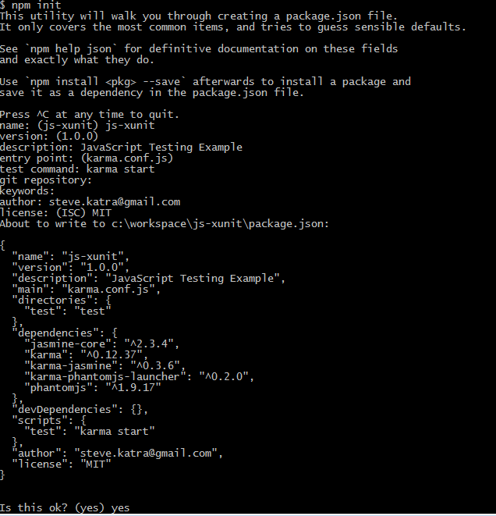

Slide 7
What is Unit Testing?
Unit testing is very important for both the quality of the code and the well being of the developer. It allows for them to freely change their code and not just hope that it’s not a breaking change, as the test will recognize the break straight away. This will minimize the number of regressions in the code. (Quinn)

Slide 8
What is Unit Testing?
Unit tests are all about splitting your code into small testable modules with each module having its own functionality and level of abstraction. (Quinn)

Slide 9
What is Unit Testing?
An added bonus is that the unit tests will act as a type of documentation because it describes the expected behavior of the functions and modules. Unit tests don’t care how your code does the task, it just cares about the results. (Quinn)

Slide 10
Step 1: Describe What’s Under Test
describe("A Stack Data Structure",function(){ //Put Test Cases Here });

Slide 11
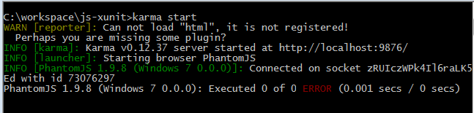
Step 0: Fire Up Karma

Slide 12
Step 2: Describe Desired Functionality
describe("A Stack Data Structure",function(){
//Positive Test Cases
it("should initialize an empty stack",function(){});
});

Slide 13
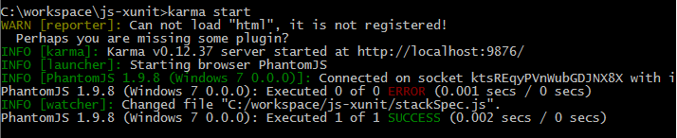

Slide 14
Step 2: Describe Desired Functionality
describe("A Stack Data Structure",function(){
//Positive Test Cases
it("should initialize an empty stack",function(){});
it("should allow you to obtain the size of the stack",function(){});
});

Slide 15
Step 2: Describe Desired Functionality
describe("A Stack Data Structure",function(){
//Positive Test Cases
it("should initialize an empty stack",function(){});
it("should allow you to obtain the size of the stack",function(){});
it("should allow a value to be pushed on to the stack",function(){});
});

Slide 16
Step 2: Describe Desired Functionality
describe("A Stack Data Structure",function(){
//Positive Test Cases
it("should initialize an empty stack",function(){});
it("should allow you to obtain the size of the stack",function(){});
it("should allow a value to be pushed on to the stack",function(){});
it("should allow multiple values to be pushed on to the stack",function(){});
});

Slide 17
Step 2: Describe Desired Functionality
describe("A Stack Data Structure",function(){
//Positive Test Cases
it("should initialize an empty stack",function(){});
it("should allow you to obtain the size of the stack",function(){});
it("should allow a value to be pushed on to the stack",function(){});
it("should allow multiple values to be pushed on to the stack",function(){});
it("should allow a value to be popped from the stack",function(){});
});

Slide 18
Step 2: Describe Desired Functionality
describe("A Stack Data Structure",function(){
//Positive Test Cases
it("should initialize an empty stack",function(){});
it("should allow you to obtain the size of the stack",function(){});
it("should allow a value to be pushed on to the stack",function(){});
it("should allow multiple values to be pushed on to the stack",function(){});
it("should allow a value to be popped from the stack",function(){});
it("should allow multiple values to be popped from the stack",function(){});
});

Slide 19
Step 2: Describe Desired Functionality
describe("A Stack Data Structure",function(){
//Positive Test Cases
it("should initialize an empty stack",function(){});
it("should allow you to obtain the size of the stack",function(){});
it("should allow a value to be pushed on to the stack",function(){});
it("should allow multiple values to be pushed on to the stack",function(){});
it("should allow a value to be popped from the stack",function(){});
it("should allow multiple values to be popped from the stack",function(){});
it("should allow you to peek at the top value on the stack without removing it",function(){});
});

Slide 20
Step 2: Describe Desired Functionality
describe("A Stack Data Structure",function(){
//Positive Test Cases
it("should initialize an empty stack",function(){});
it("should allow you to obtain the size of the stack",function(){});
it("should allow a value to be pushed on to the stack",function(){});
it("should allow multiple values to be pushed on to the stack",function(){});
it("should allow a value to be popped from the stack",function(){});
it("should allow multiple values to be popped from the stack",function(){});
it("should allow you to peek at the top value on the stack without removing it",function(){});
//Negative Test Cases
it("should not allow you to pop from an empty stack",function(){});
});

Slide 21
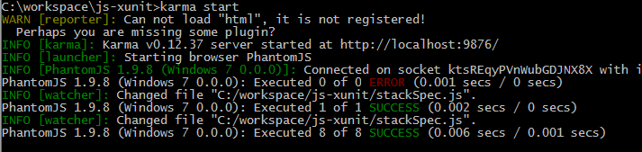

Slide 22
Step 3: Add Assertions
describe("A Stack Data Structure",function(){
var stack;
//Positive Test Cases
it("should initialize an empty stack",function(){
stack = new Stack();
expect(stack).toBeDefined();
});
});

Slide 23
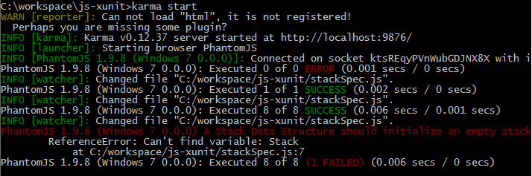

Slide 24

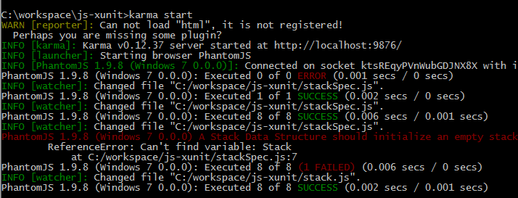
Step 4: Add Code To Make Tests Pass

Slide 25


Step 5: Add Another Assertion

Slide 26
Step 6: Add Code To Make Tests Pass

Slide 27

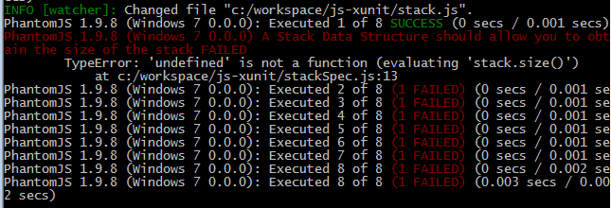
Step 7: Add Additional Assertion

Slide 28
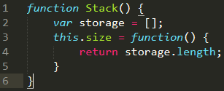
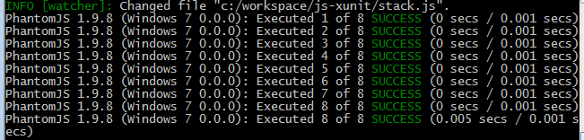
Step 8: Add Code To Make Tests Pass

Slide 29
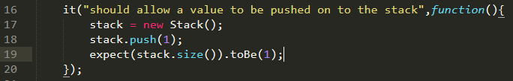
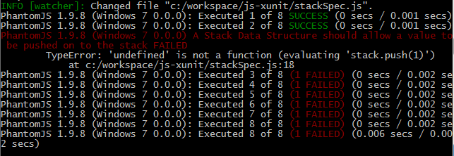
Step 9: Add Additional Assertion

Slide 30

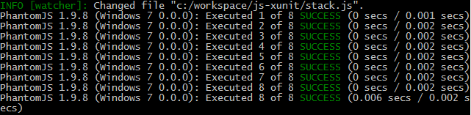
Step 10: Add Code To Make Tests Pass

Slide 31
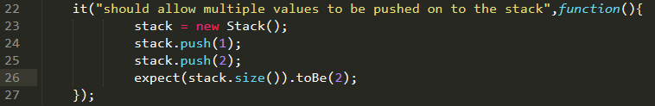
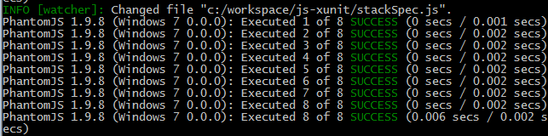
Step 11: Add Additional Assertion

Slide 32
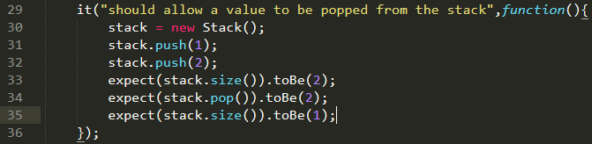
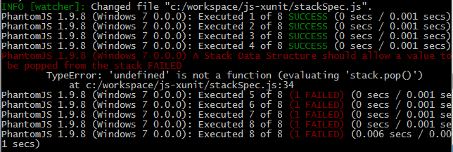
Step 12: Add Additional Assertion

Slide 33

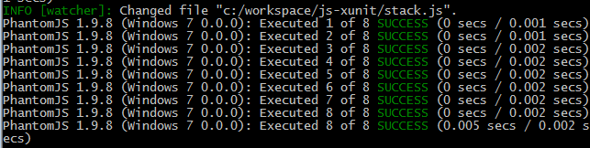
Step 13: Add Code To Make Tests Pass

Slide 34
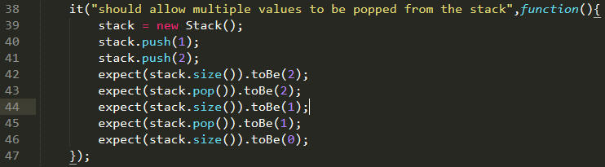
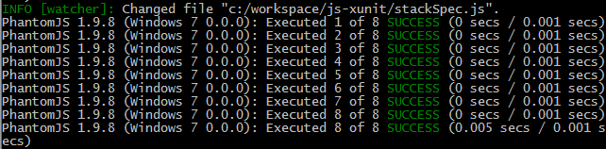
Step 14: Add Additional Assertion

Slide 35
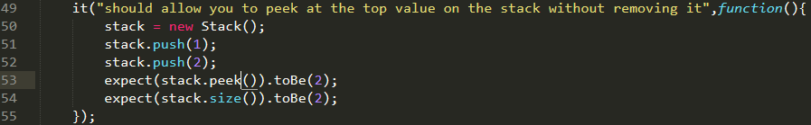
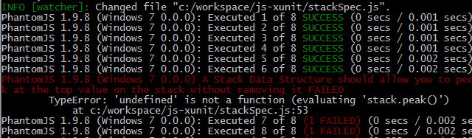
Step 15: Add Additional Assertion

Slide 36

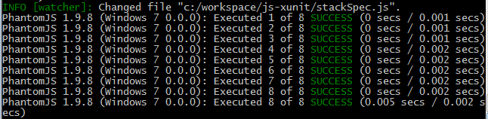
Step 16: Add Code To Make Tests Pass

Slide 37
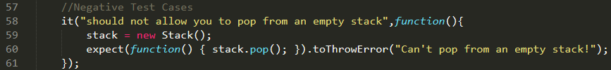
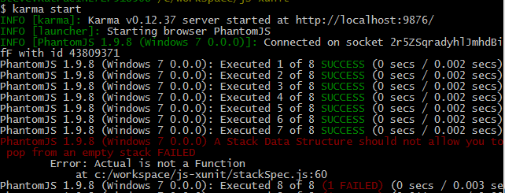
Step 17: Add Additional Assertion

Slide 38
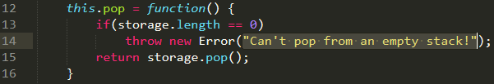
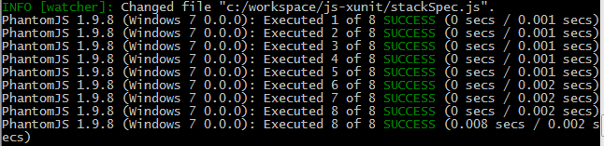
Step 18: Add Code To Make Tests Pass

Slide 39
References
Quinn, P. (2015, January 20). Unit testing with Karma and Jasmine for AngularJS. Retrieved July 13, 2015.

